Slide 1


1
TEACING PLATFORM FOR LEARNING BY VOICE CONTROL
TRAVEL-WITH-US APPLICATION
PRESENTED BY:
PELEG OANUNO
RON LAHIANI
SUPERVISOR: MOSHE SULAMY
Capstone Project Phase A-24-1-D-32

Slide 2


INTRODUCTION:
2
Traditional language learning is often dull and ineffective, relying on rote memorization.
There is a need for a more engaging and practical approach to language learning.

Slide 3

THE PROBLEM:
3
The current methods of language learning lack interactivity and fail to provide learners with practical, real-life examples of language use
Learners struggle to apply language skills in real-life situations, such as in a foreign country.

Slide 4



PROPOSED SOLUTION:
4
Develop a Unity game that teaches languages through orientation in a foreign country.
Immersive scenarios will require players to use the language to navigate and interact.

Slide 5

PROJECT GOALS:
5
Revolutionize language learning with an engaging and practical approach.
Make language learning enjoyable and accessible to all.
Bridge the gap between theoretical knowledge and practical language use.

Slide 6
PROJECT GOALS:
6
Enhance cultural awareness and sensitivity.
Utilize technology and gamification for more effective learning.

Slide 7
UNIQUE FEATURES:
7
VOICE RECOGNETION
Google cloud Speech-to-text
PROGRESS TRACKING
Providing progress tracking to the user
GAMIFCATION
CLOUD TECHNOLOGY
Predictive Tools Maintenance
Using Google cloud

Slide 8

EXECUTION PLAN:
8
Research Approaches:
Conducting a thorough literature review to understand the latest advancements in voice recognition technology and language learning.
Algorithms:
Selecting and implementing state-of-the-art voice recognition algorithms that can handle various accents and languages.

Slide 9



EXECUTION PLAN:
9
3.Technology Stack:
Utilizing Unity for game development, Google Cloud Speech-to-Text for voice recognition, and possibly other APIs for additional functionalities.

Slide 10


EXECUTION PLAN:
10
4.RESEARCH/ENGINEERING DEVELOPMENT PROCESS:
01 02
03
04
DEVELOPMENT:
implementing voice recognition
technology within the Unity environment, integrating feedback mechanisms.
TESTING AND OPTIMIZATION:
Testing the application for accuracy,
performance, and user experience, and optimizing the system based on feedback.
DEPLOYMENT AND EVALUATION:
Deploying the application for user testing, gathering feedback, and evaluating the effectiveness of the language learning experience.
RESEARCH AND PLANNING:
Conducting initial research, defining project goals, and planning the development process.

Slide 11


CHALLENGES IN ENGINEERING RESEARCH/DEVELOPMENT:
11
Voice Recognition Accuracy.
2. Real-Time Processing.

Slide 12



CHALLENGES IN ENGINEERING RESEARCH/DEVELOPMENT:
12
Integration with Unity
4. Noise Cancellation

Slide 13

CHALLENGES IN ENGINEERING RESEARCH/DEVELOPMENT:
13
Language Support.
User Experience.

Slide 14




UNITY ENGINE
14
Cross-platform development C#
Support for 2D and 3D graphics Psychics simulation
Intuitive editor workspace for scene
assembly

Slide 15

UNITY APPLICATION
15
Model
Controller
The Model would handle ineractions with Google Cloud DB and it would retrieve data from the game.
The Controller would handle the game logic and scene managmenet
View
The View layer is responsible for presenting the game’s inerface and visual elements

Slide 16
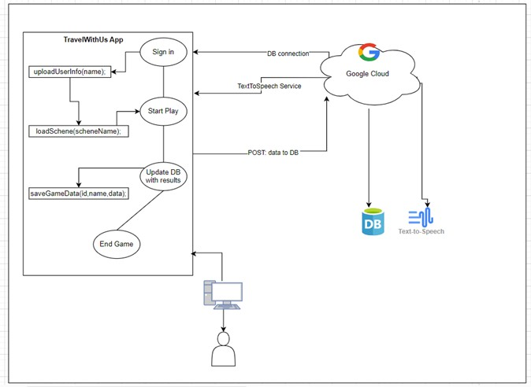
¹⁶ ARCHITECTURE OVERVIEW
Unity engine
Voice recognition Cloud technology
DataBase

Slide 17
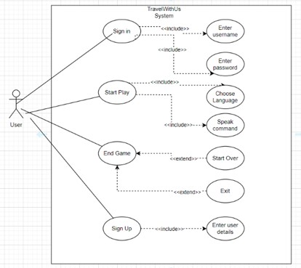
USE-CASE DIAGRAM
17

Slide 18
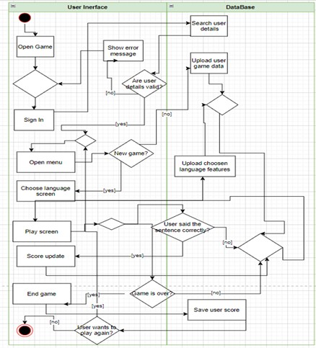
ACTIVITY DIAGRAM
18

Slide 19
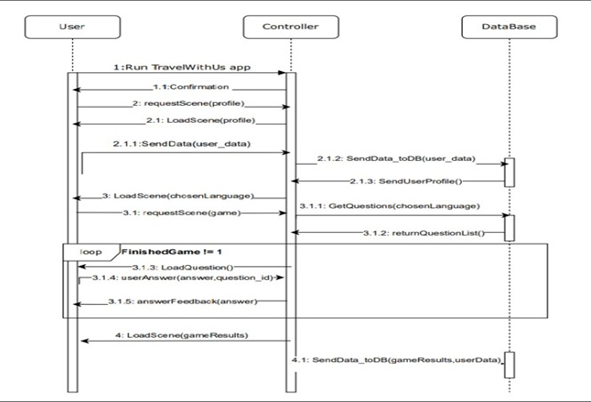
SEQUENCE DIGARAM
19

Slide 20
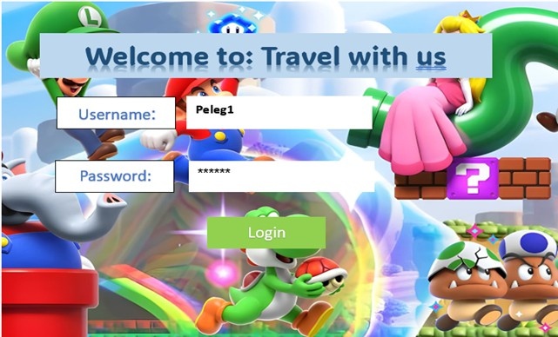
USER INTERFACE - WELCOME SCREEN
20

Slide 21
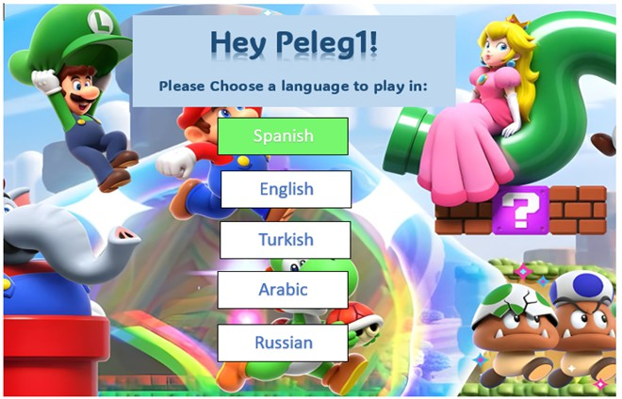
USER INTERFACE - MAIN MENU
21

Slide 22
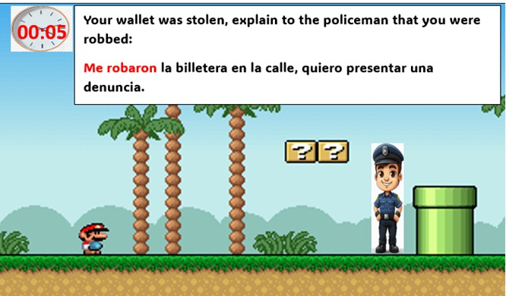
USER INTERFACE – Game Screen
22

Slide 23


OUR GAME VS MARKET OFFERINGS
23
Aspect TravelWithUS
Market
offerings
Voice recognition
Text based interaction
Intercation
Provides real- time feedback on pronancing
May not be as immediate or focused on speaking skills
broad range of language learners
Relies on internal speech recognition algorithms or external services
Feedback
Target Audience
Appeals to travelers
Integrates Google's Speech-to-Text API for accurate voice recognition
Technology Integration

Slide 24



VERIFICATION AND EVALUATION
24
Identify potential issues Seek areas of improvement
Ensure the quality and effectiveness User feedback
Performance evaluation

Slide 25


TESTING PLAN
25
Unity engine
Scene loading and transitioning
Verify that all game components and features function correctly within the Unity environment.
Test user interaction
Game mechanics and animations

Slide 26
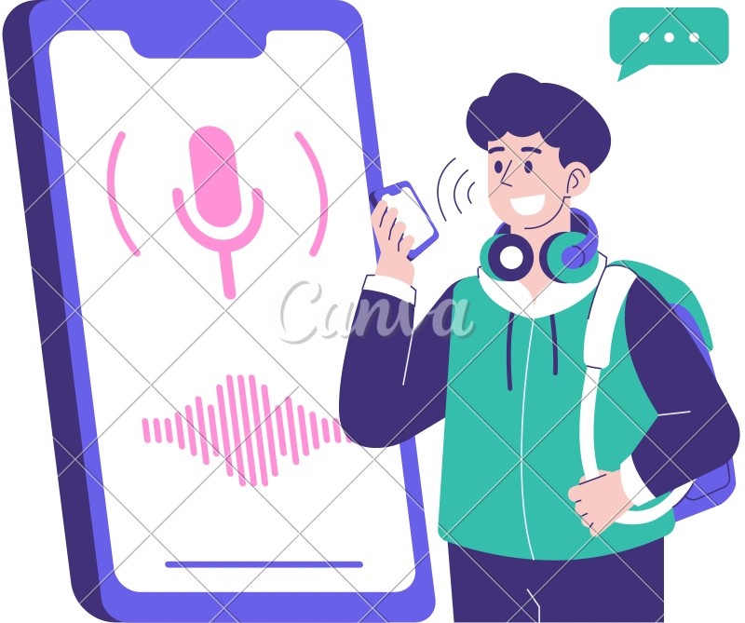
TESTING PLAN
26
Voice recognition
Accuracy testing Noise Tolerance Testing
Real-time Performance Testing Error Handling Testing

Slide 27

TESTING PLAN
27
Cloud storage
Data accessibility Cross-Platform Testing
Backup and Recovery Security Testing

Slide 28





ANY QUESTIONS?

